Slide 1
COMPUTER GRAPHICS PROJECT PRESENTATION
Course Name | Computer Graphics
Section | F
Course Tutor | ANEEM AL AHSAN RUPAI
Group Members Information:
Name | ID
Abdullah Al Amin | 19-39502-1
Rezaul Karim | 19-39521-1
Dip Roy | 19-39544-1

Slide 2
INTRODUCTION
The project will demonstrate scenario of a “Sea-Mountain View of Winter” and “City View of Summer and Rainy session”. We implemented a scenario of mountain and sea in winter view when snowfall will happen. In the next scenario, we implemented a city life where day and night view will be shown. There will be rain feature in day and night view by pressing a keyboard button in the city view. There will be also snow feature in sea mountain scene. There are multiple animation in this project. All together it would render an eye pleasing sea-mountain sights and city view scenario.

Slide 3
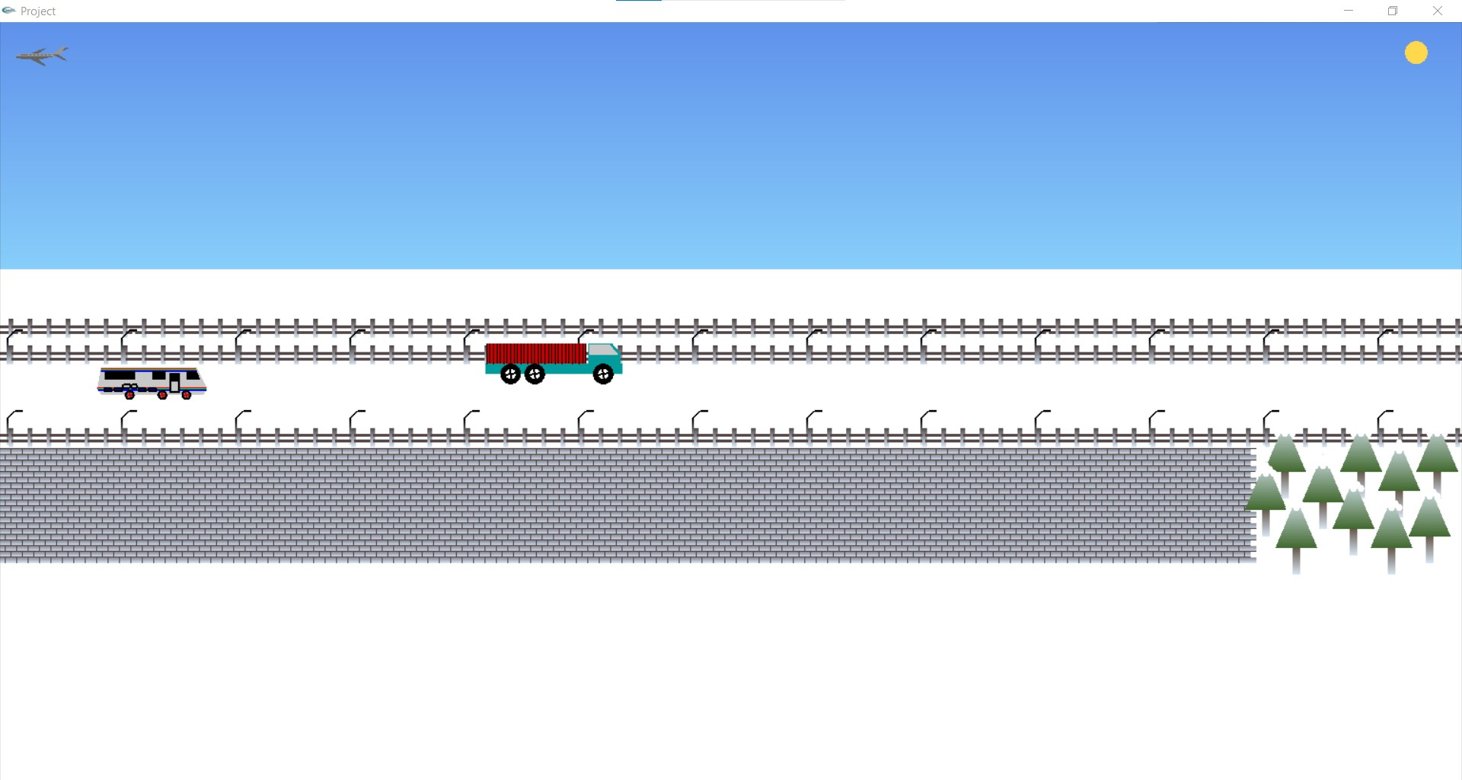
TASK ASSIGNMENT
Contributor Name: Abdullah Al Amin
Object Functions | Function Name | ID NO
 | void plane() | 3201
 | void plane_1() | 3202
 | void sky() | 0201
 | void truck_tire1() | 360101
 | void truck_tire2() | 360102
 | void truck_tire3() | 360102
 | void truck () | 3601
 | void truck_1 () | 3602
 | void rv_tire1() | 370101
 | void rv_tire2() | 370102
 | void rv_tire3() | 370103
 | void rv() | 3701
 | void rv_1() | 3702
 | void building1() | 2201
 | void building4() | 2204
OUTPUT

Slide 4

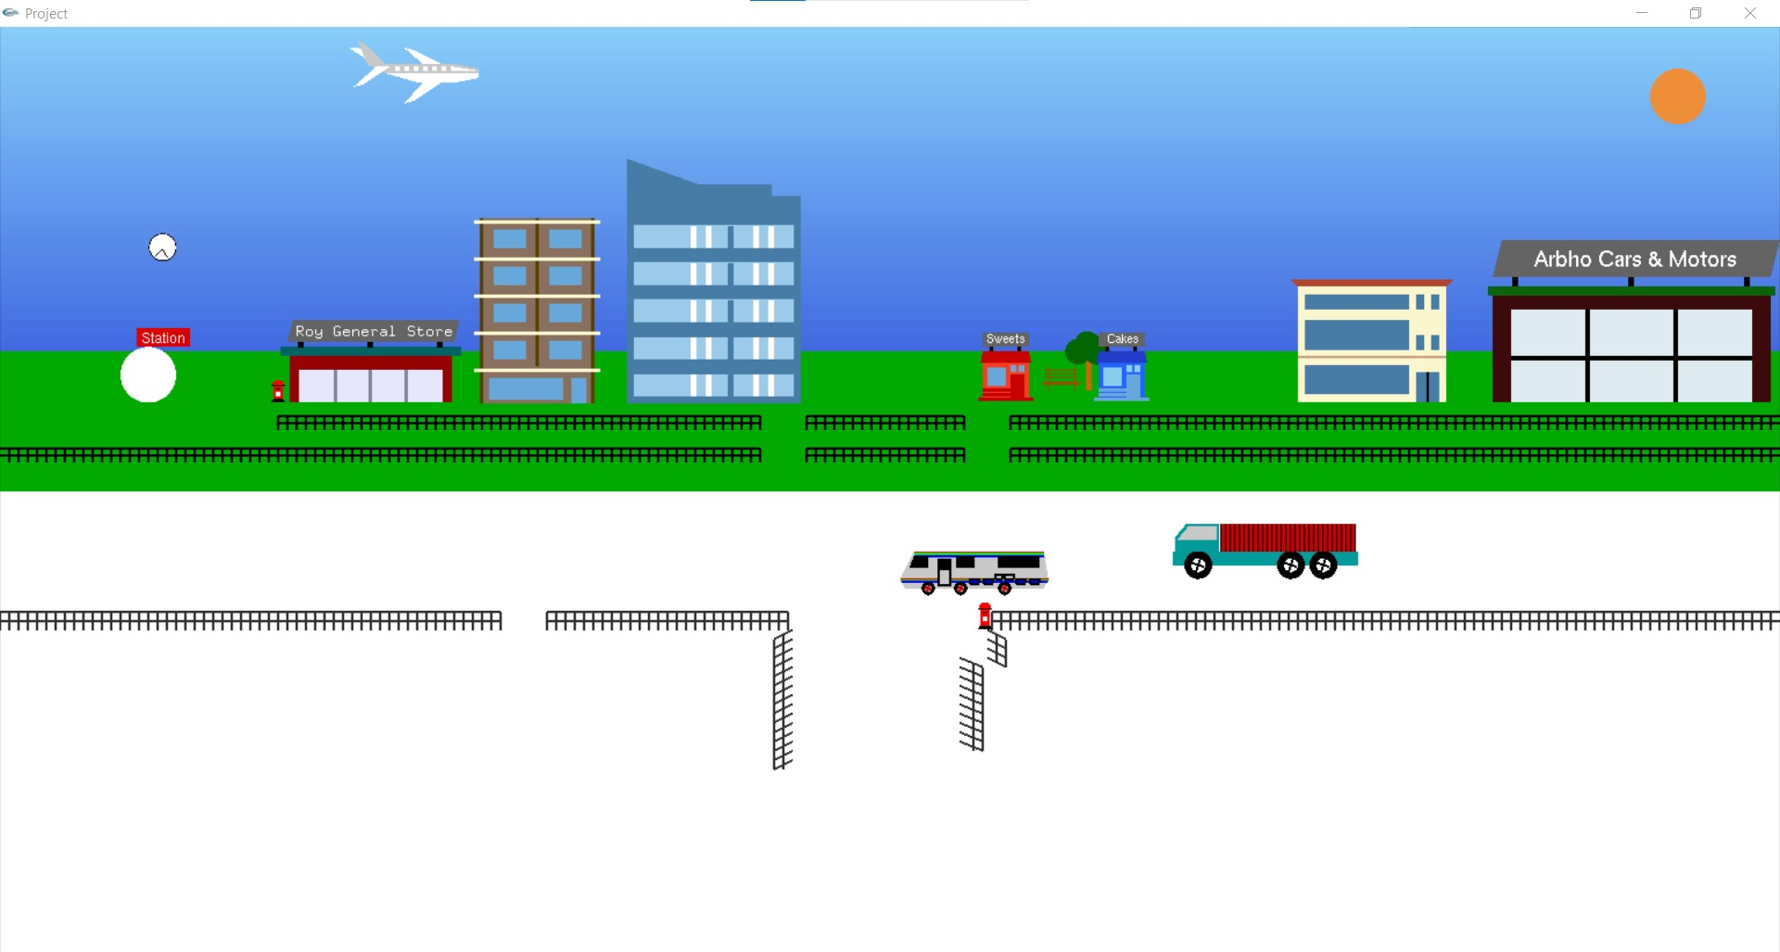
Contributor Name: Abdullah Al Amin
 | void mall() | 2205
 | void shop() | 2206
 | void car_shop() | 2207
 | void mini_shop_1() | 2208
 | void mini_shop_2() | 2209
 | void sun() | 2301
 | void moon() | 2401
 | void ralling1() | 1001
 | void ralling2() | 1002
 | void ralling3() | 1003
 | void fence() | 1101
 | void fance_train_top() | 1102
 | void fance_train_buttom() | 1103
 | void lampost_top_1() | 1201
 | void lampost_buttom_1() | 1202
 | void lampost() | 1203
 | void post_box_park() | 1701
 | void post_box_trump() | 1702
 | void snow_shade_tree_0() | 2709
 | void snow_shade_tree() | 2710

Slide 5
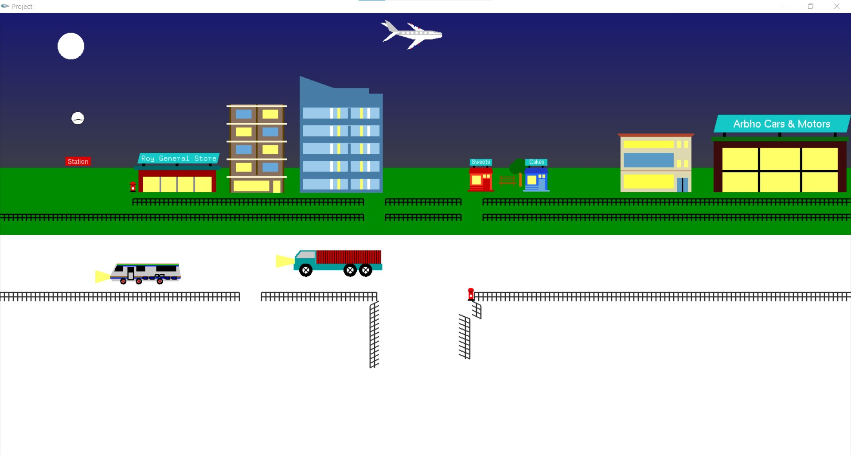
Contributor Name: Abdullah Al Amin
Interactive Functions | Function Name | ID NO
 | void update_station_clock(int value) | 2210001
 | void update_sun(int value) | 2301001
 | void update_moon(int value) | 2401001
 | void update_plane(int value) | 3201001
 | void update_tuck_tire(int value) | 3601001
 | void update_tuck(int value) | 3601002
 | void update_tuck_1(int value) | 3602001
 | void update_rv_tire(int value) | 3701001
 | void update_rv(int value) | 3701002

Slide 6
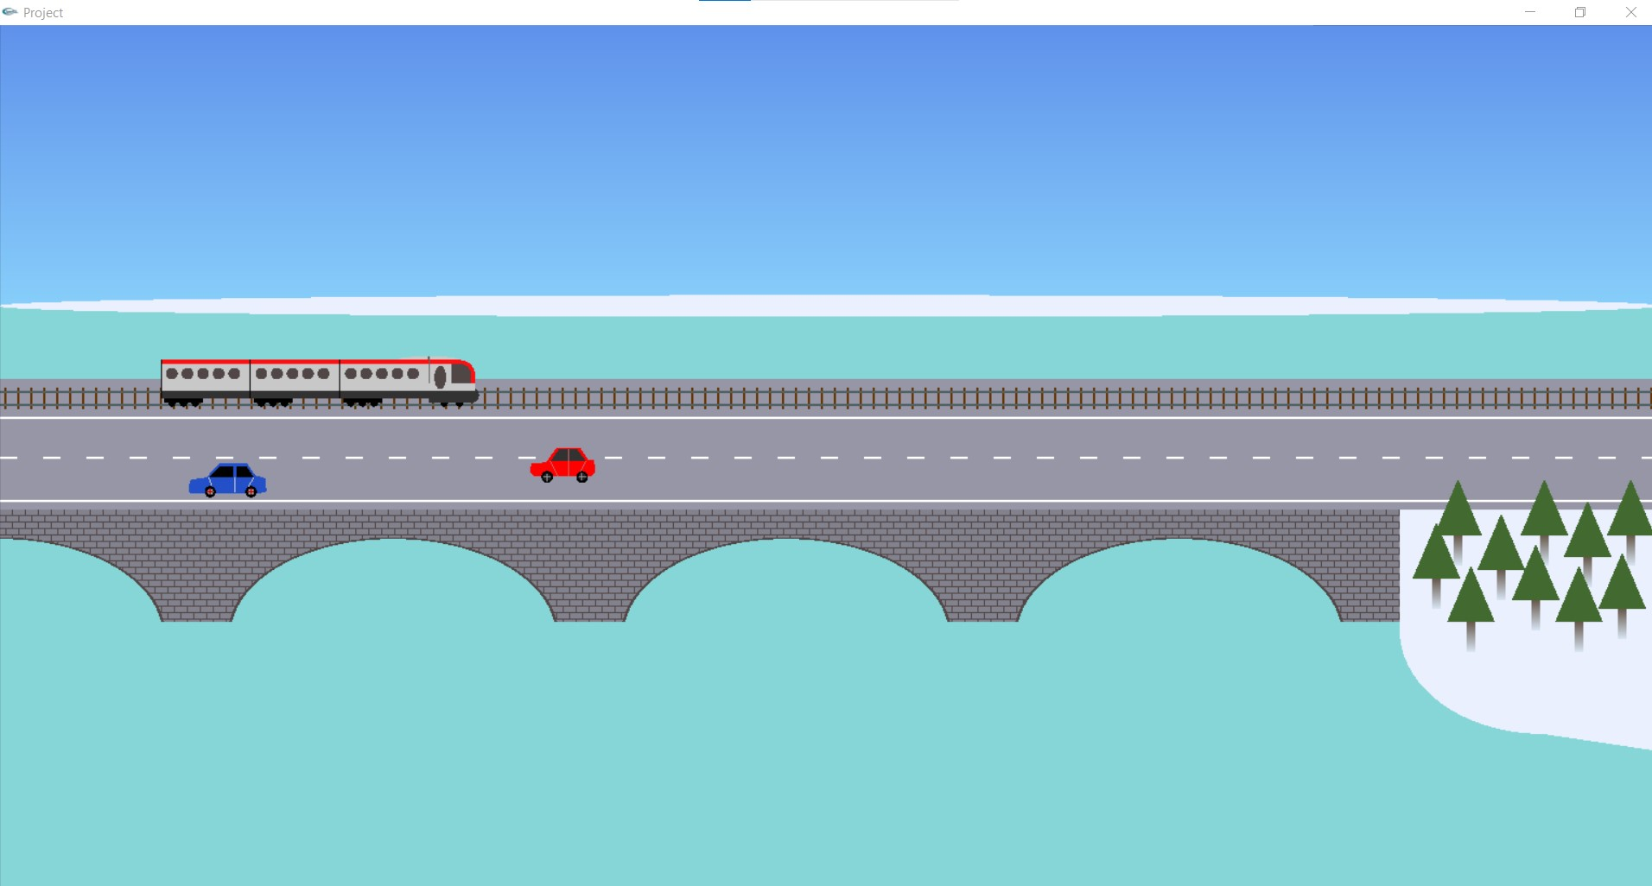
TASK ASSIGNMENT
Contributor Name: Karim, Rezaul
Object Functions | Function Name | ID NO
 | void star() | 0101
 | void star1() | 010101
 | void star3() | 010102
 | void star2() | 010103
 | void snow1() | 2701
 | void snow_cloud() | 2801
 | void snow_cloud1() | 2802
 | void snow2() | 2702
 | void snow3() | 2703
 | void snow4() | 2704
 | void snow5() | 2705
 | void snow() | 2706
 | void snowfall_1() | 2707
 | void snowfall_2() | 2708
 | void heli_blade1() | 330101
 | void heli_blade2() | 330102
 | void heli_body() | 330103
OUTPUT

Slide 7

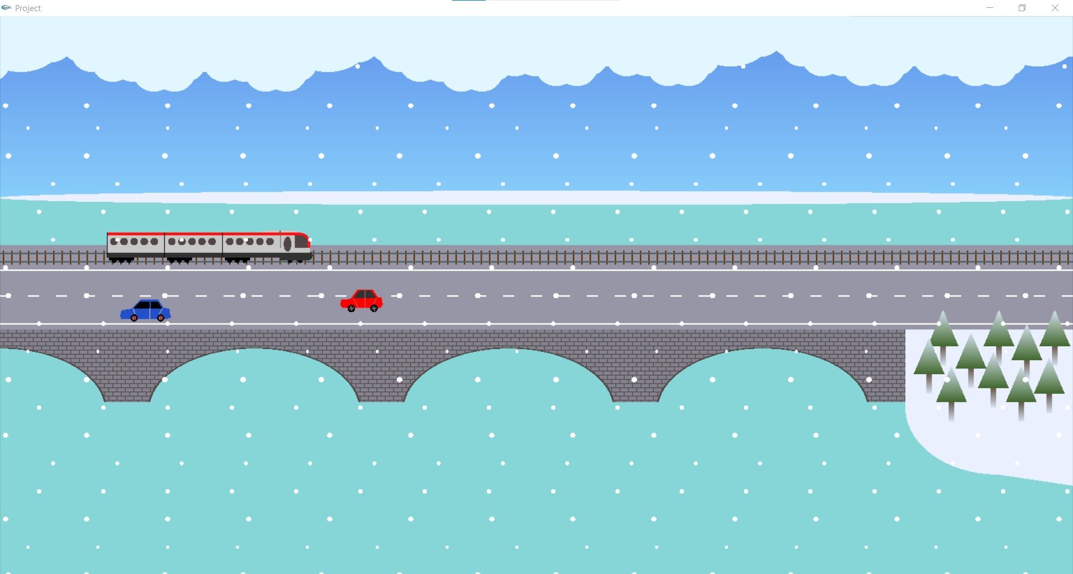
Contributor Name: Karim, Rezaul
 | void helicopter() | 3301 | void c1_body() | 380101
 | void glacier() | 0401 | void c1_tire1() | 380102
 | void grass() | 0501 | void c1_tire2() | 380103
 | void bridge() | 0601 | void car1() | 3801
 | void bridge_1() | 0602 | void car1_1() | 3802
 | void road() | 0701 | void c2_body() | 380301
 | void roadsign() | 0801 | void c2_tire1() | 380302
 | void traffic() | 0901 | void c2_tire2() | 380303
 | void traffic1() | 0902 | void car2() | 3803
 | void lake() | 2501 | void c1_body() | 380101
 | void t_body() | 350101 | void tree_7() | 1307
 | void t_body2() | 350102 | void tree_8() | 1308
 | void t_body3() | 350103 | void tree_9() | 1309
 | void t_body4() | 350104 | void field_tree2() | 1312
 | void trump() | 3501 | void field_tree3() | 1313
 | void trump_1() | 3502 | void field_tree4() | 1314
 | void dock() | 2101 | void cloud_13() | 2614
 | void building2() | 2202 | void cloud_14() | 2615
 | void building3() | 2203 | void cloud_15() | 2616
 | void snow_cloud() | 2801 | void cloud_16() | 2617
 | void snow_cloud1() | 2802

Slide 8
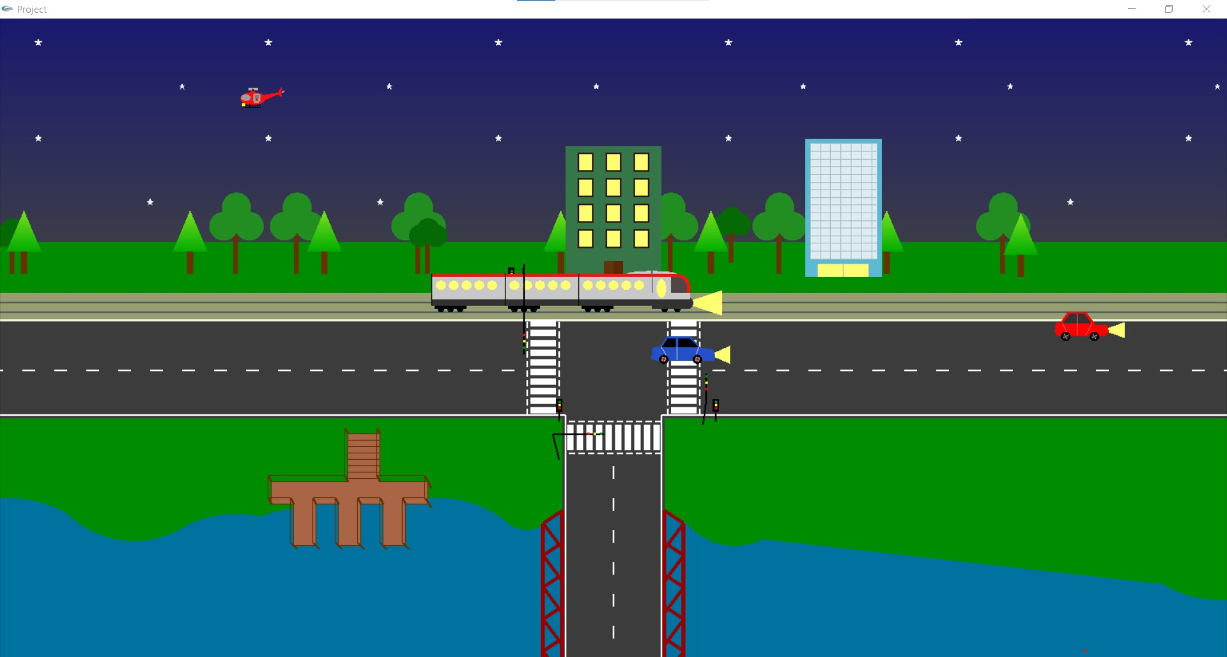
Contributor Name: Karim, Rezaul
Interactive Functions | Function Name | ID NO
 | void update_wave(int value | 2501001
 | void snow_update(int value) | 2701001
 | void snow_update1(int value) | 2701002
 | void snow_cloud_update(int value) | 2801001
 | void snow_cloud_stop(int value) | 2801002
 | void trump_update(int value) | 3501001
 | void trump_1_update(int value) | 3502001
 | void car2_angle(int value) | 3801001
 | void car2move(int value) | 3801002
 | void car1move(int value) | 3801003
 | void car1angle(int value) | 3801004
 | void helicopter_angle(int value) | 3301001
 | void helicopter_movex(int value) | 3301002
 | void helicopter_movey(int value) | 3301003

Slide 9
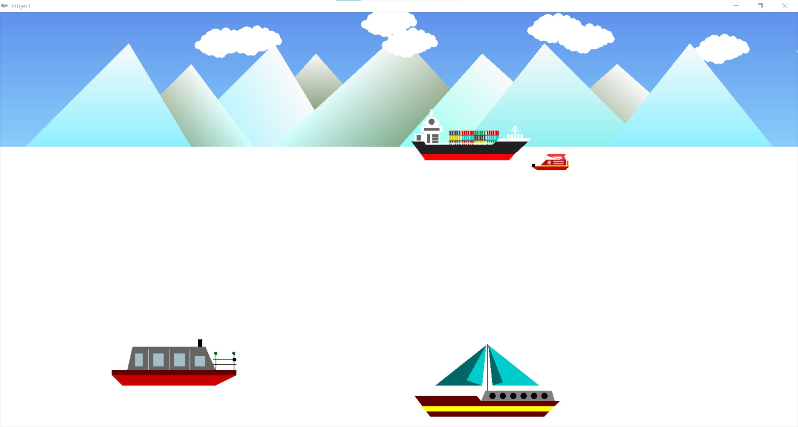
TASK ASSIGNMENT
Contributor Name: Roy Dip
Object Functions | Function Name | ID NO
 | void park_road() | 1901
 | void park_bench() | 2001
 | void dustbin() | 1601
 | void station() | 2210
 | void rain_cloud() | 2901
 | void rain_cloud1() | 2902
 | void rain() | 3001
 | void ship_2() | 3402
 | void boat_1() | 3403
 | void boat_11() | 3405
 | void boat_2() | 3404
 | void boat_21() | 3406
 | void bush() | 1501
 | void bush_1() | 1502
 | void bush_2() | 1503
 | void bush_3() | 1504
 | void bush_4() | 1505
 | void bush_5() | 1506
 | void bush_6() | 1507
OUTPUT

Slide 10

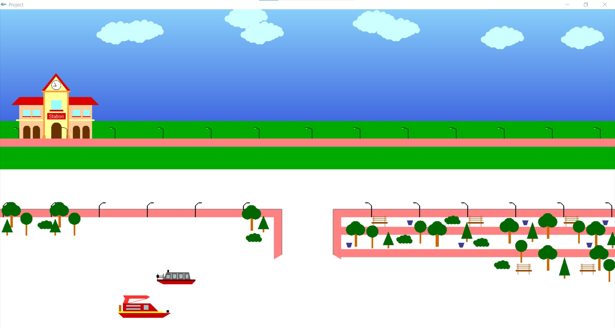
Contributor Name: Roy Dip
 | void cloud() | 2601 | void ship_container() | 340103
 | void cloud_1() | 2602 | void ship_container_1() | 340104
 | void cloud_2() | 2603 | void ship_container_2() | 340105
 | void cloud_3() | 2604 | void ship_container_3() | 340106
 | void cloud_4() | 2605 | void ship_container_4() | 340107
 | void cloud_5() | 2606 | void ship_container_5() | 340108
 | void cloud_6() | 2607 | void ship_container_6() | 340109
 | void cloud_7() | 2608 | void ship_container_7() | 340110
 | void cloud_8() | 2609 | void ship_container_8() | 340111
 | void cloud_9() | 2610 | void ship_container_9() | 340112
 | void cloud_10() | 2611 | void ship_container_10() | 340113
 | void cloud_11() | 2612 | void ship_container_11() | 340114
 | void cloud_12() | 2613 | void ship_container_12() | 340115
 | void lampost() | 1203 | void ship() | 3401
 | void footpath() | 1801 | void mountain() | 0301
 | void mountain() | 0301 | void tree_5() | 1305
 | void tree_1() | 1301 | void tree_6() | 1306
 | void tree_2() | 1302 | void field_tree1() | 1311
 | void tree_3() | 1303 | void field_tree1() | 1311
 | void tree_4() | 1304

Slide 11
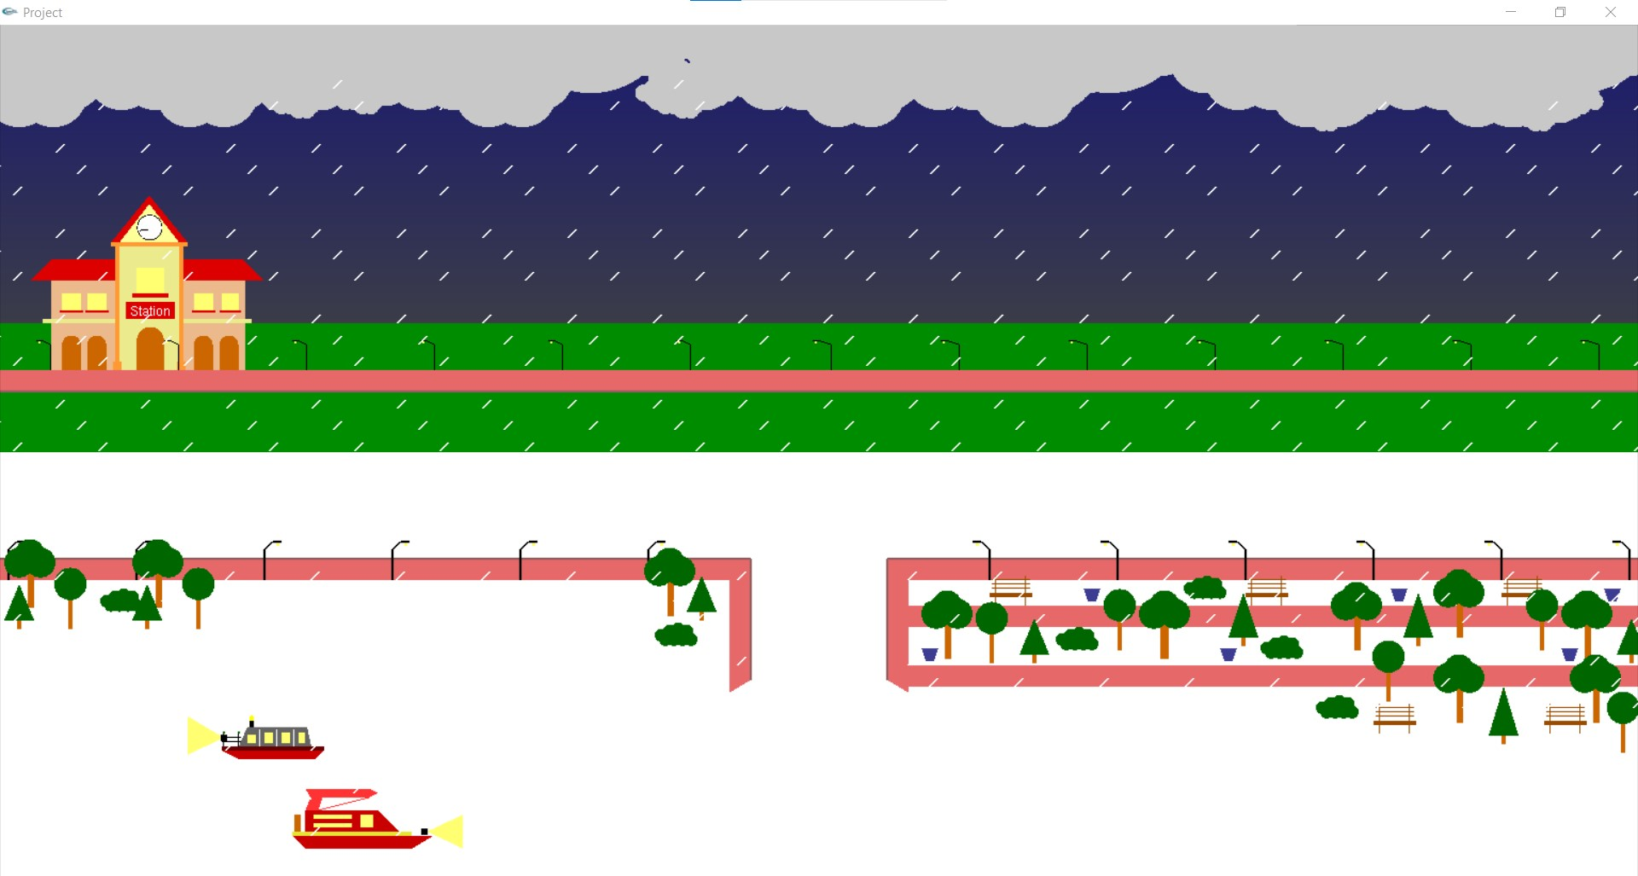
Contributor Name: Roy Dip
Interactive Functions | Function Name | ID NO
 | void update_cloud(int value | 2601001
 | void rain_cloud_update(int value) | 2901001
 | void rain_cloud_stop(int value) | 2901002
 | void rain_update(int value) | 3001001
 | void update_ship_1(int value) | 3401001
 | void update_ship_2(int value) | 3402001
 | void update_boat_1(int value) | 3403001
 | void update_boat_2(int value) | 3404001
 | void update_boat_21(int value) | 3406001

Slide 12
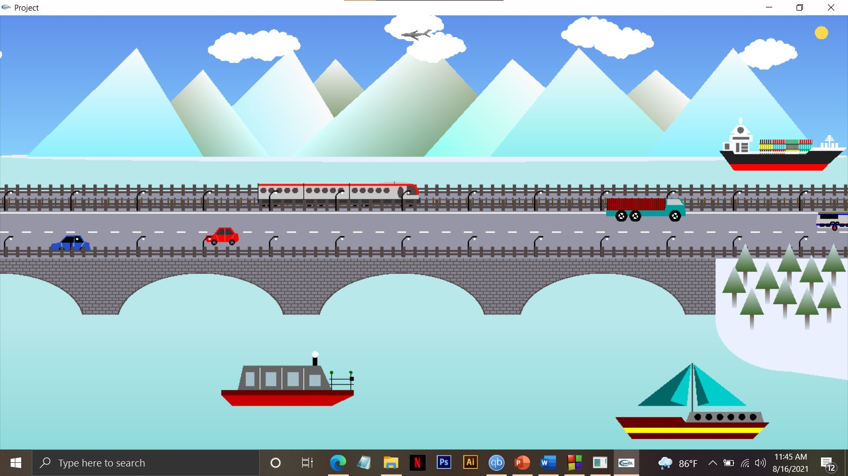
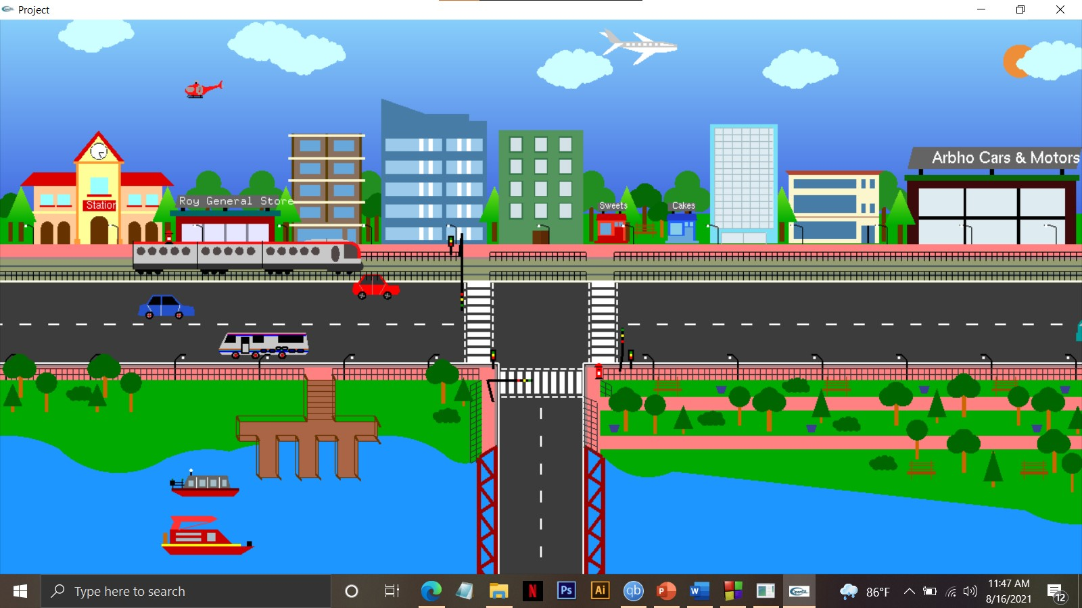
MERGE PROJECT OUTPUT
DAY VIEW1
DAY VIEW2

Slide 13
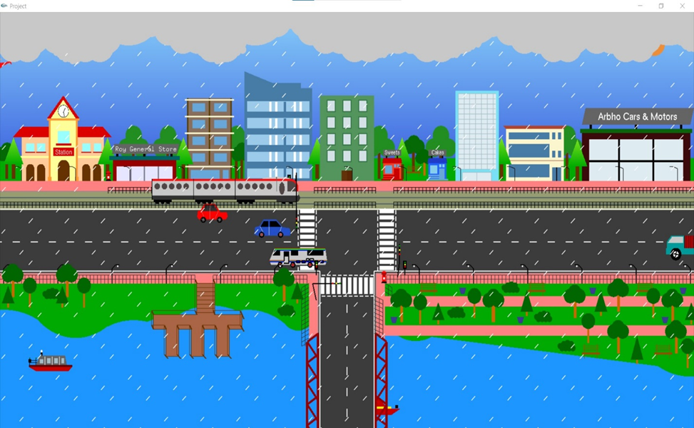
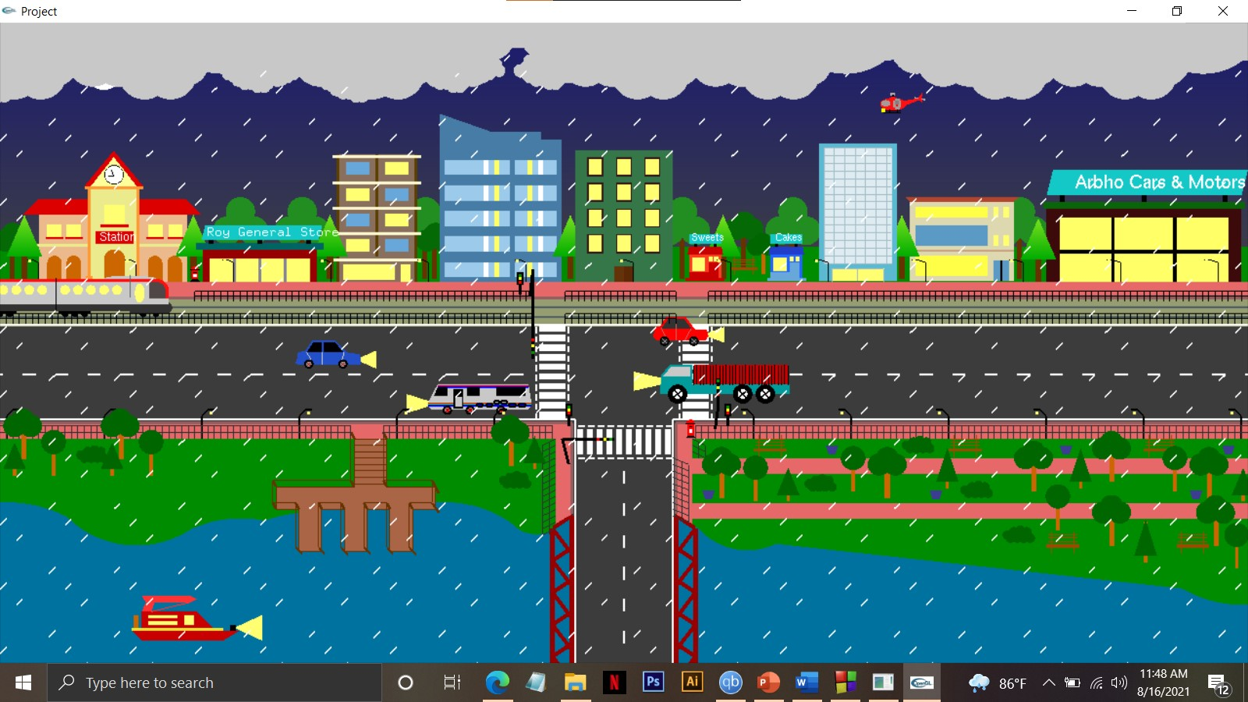
MERGE PROJECT OUTPUT
Rain VIEW1
RAIN VIEW2

Slide 14
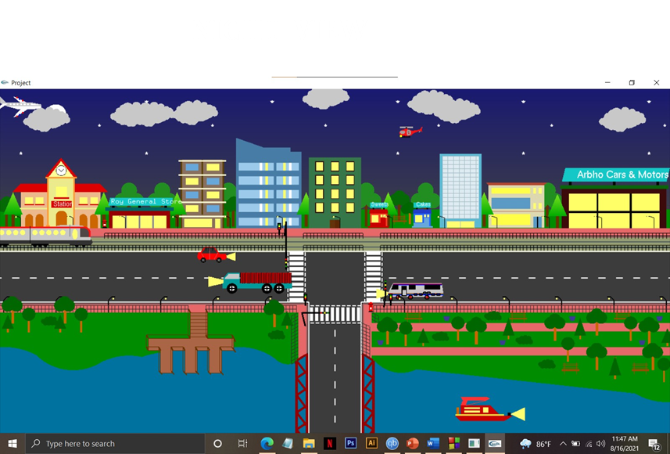
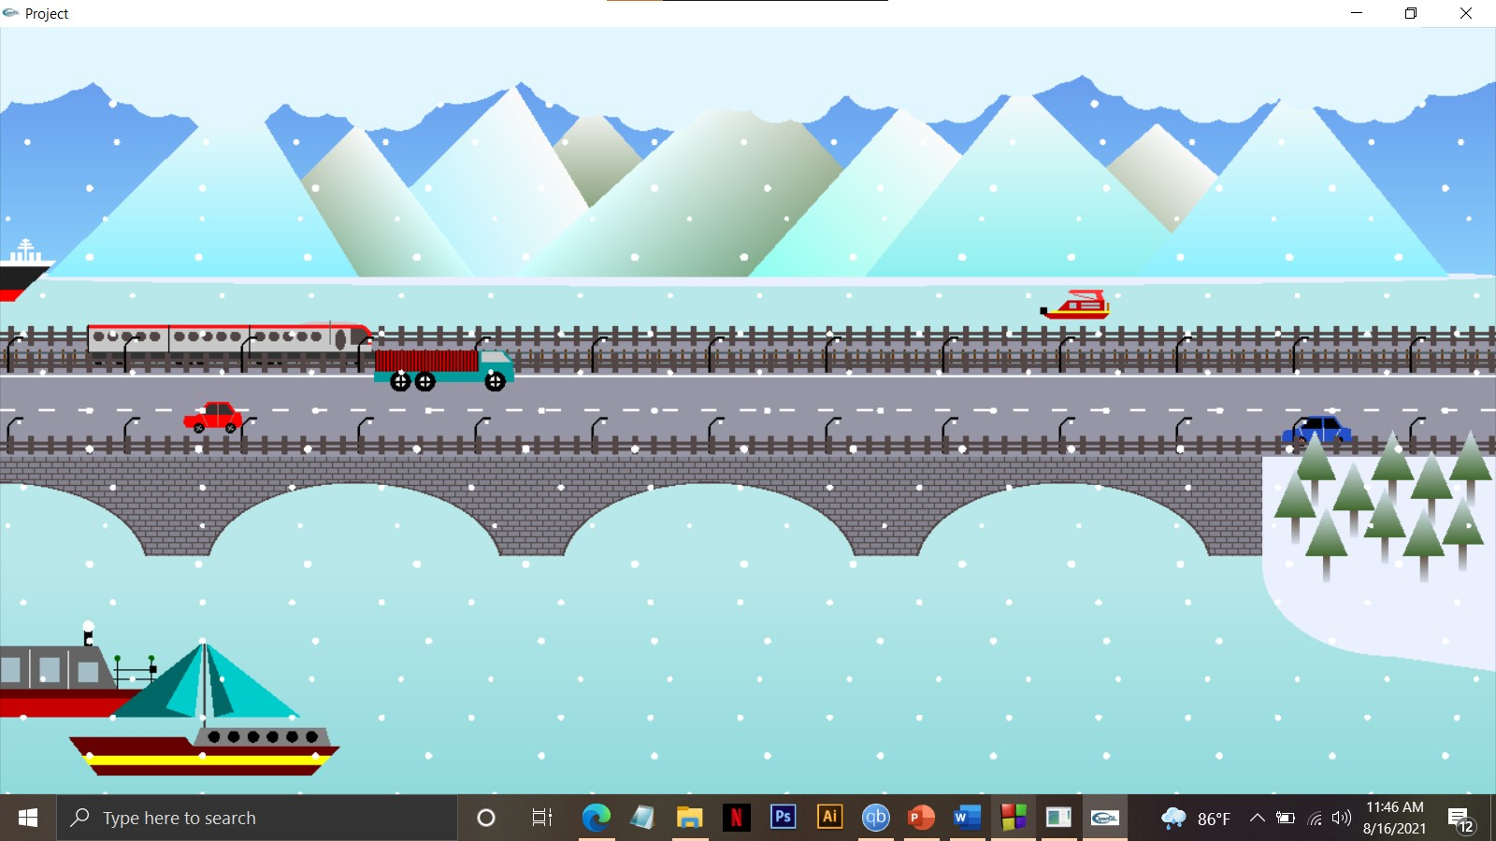
MERGE PROJECT OUTPUT
SNOW VIEW

